Slide 1
Visuals from Tableau
Jiashan Wu

Slide 2
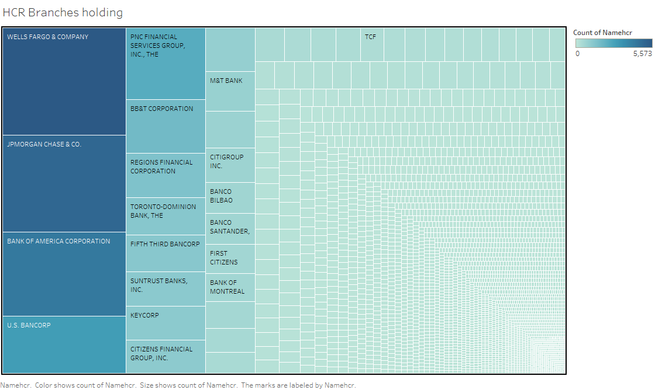

Slide 3
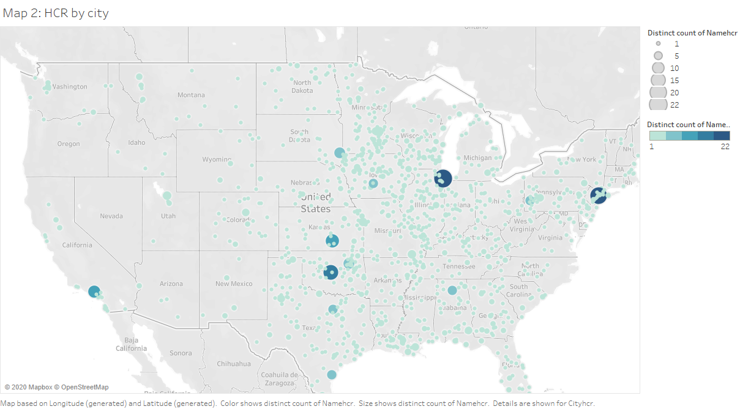

Slide 4
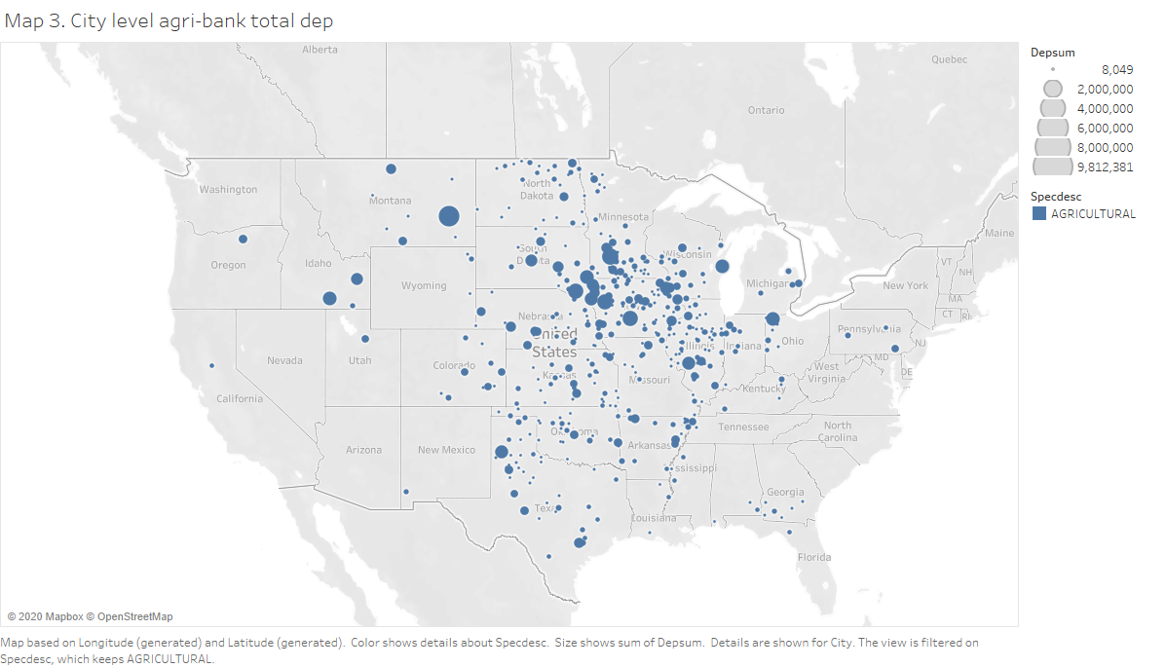

Slide 5
